Slide 1
Rural Perspective
Culture & Coverage Forum
Terri Hurst, MSW
Policy Analyst

Slide 2
Culture & Coverage Forum
Colorado Rural Health Center
Serve as State Office of Rural Health
Programs & Services
  Federally certified Rural Health Clinics (52)
  Critical Access Hospitals (29)
  Provider Recruitment & Retention
  Grant Programs
  Community Development
  Advocacy

Slide 3
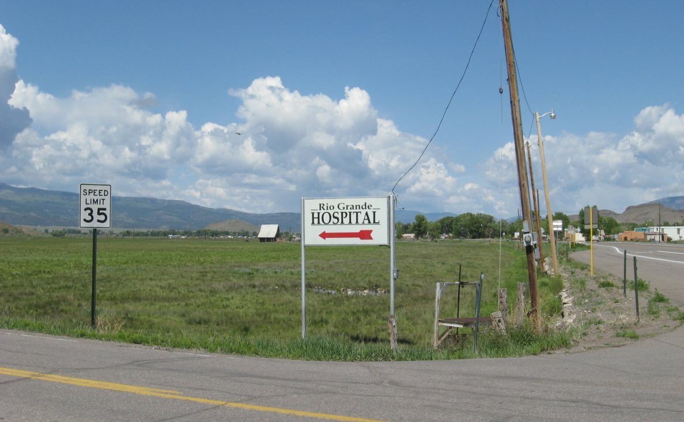
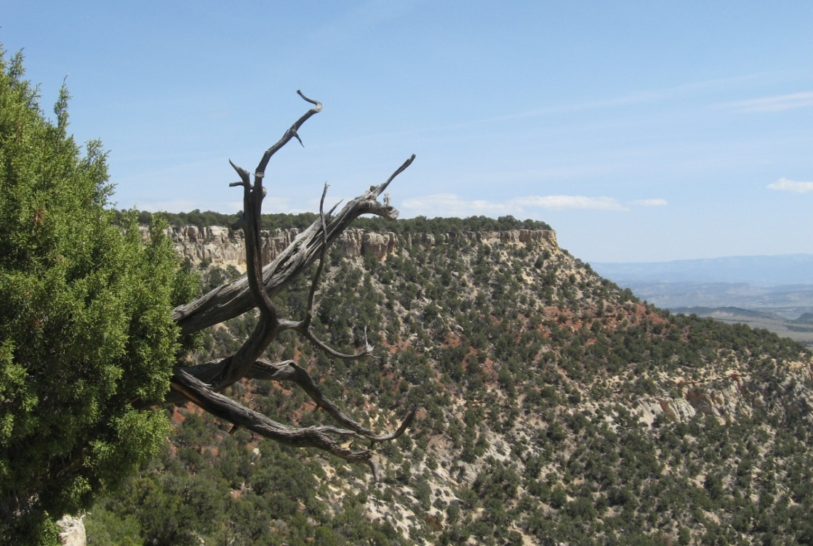
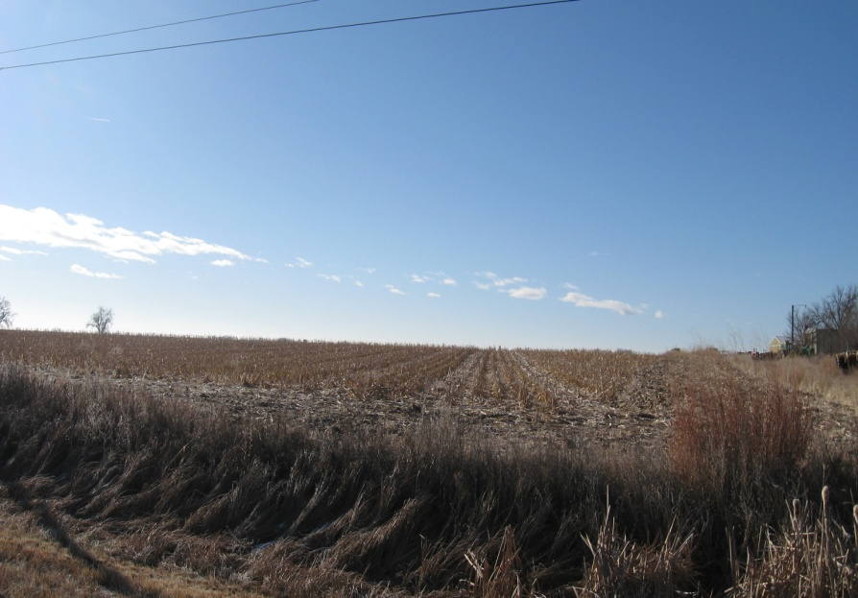
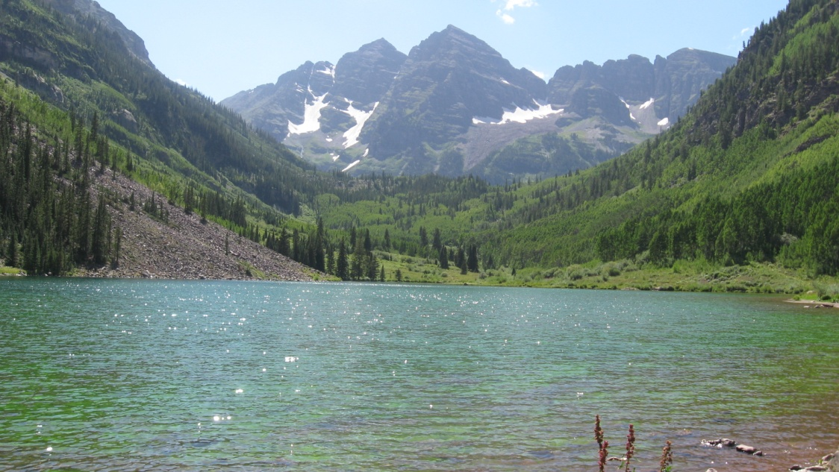

Culture & Coverage Forum
What is Rural?

Slide 4
Culture & Coverage Forum
What is Rural?
Colorado – 4 distinct regions
  Eastern Plains, Front Range (urban), Rural Resort, Western Slope
Over 20 definitions of “rural” used by federal government in regards to healthcare
Approximately 80% of Colorado
  (~ 17% of population)

Slide 6
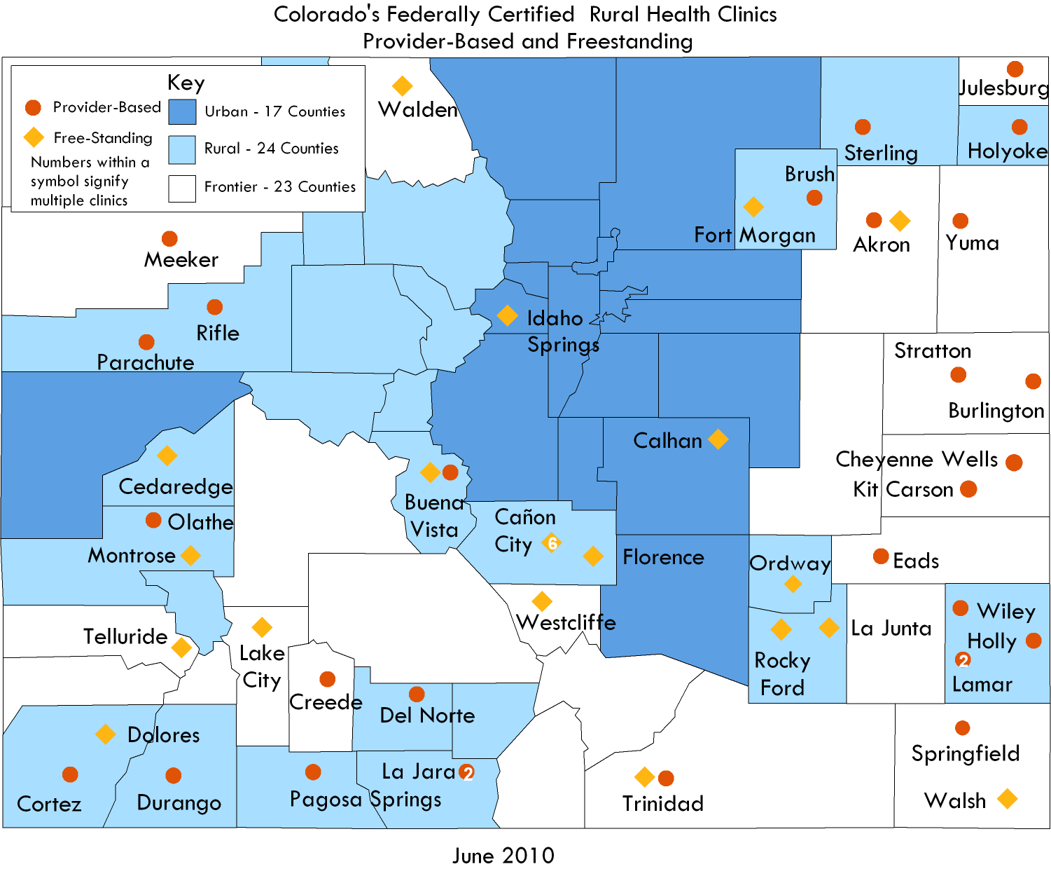
Culture & Coverage Forum
Notes:
Four pediatric RHCs: Pediatric Associates of Canon City, Sabatini Pediatrics, Ft. Morgan Pediatric Clinic, Pediatric Associates of Montrose

Slide 7
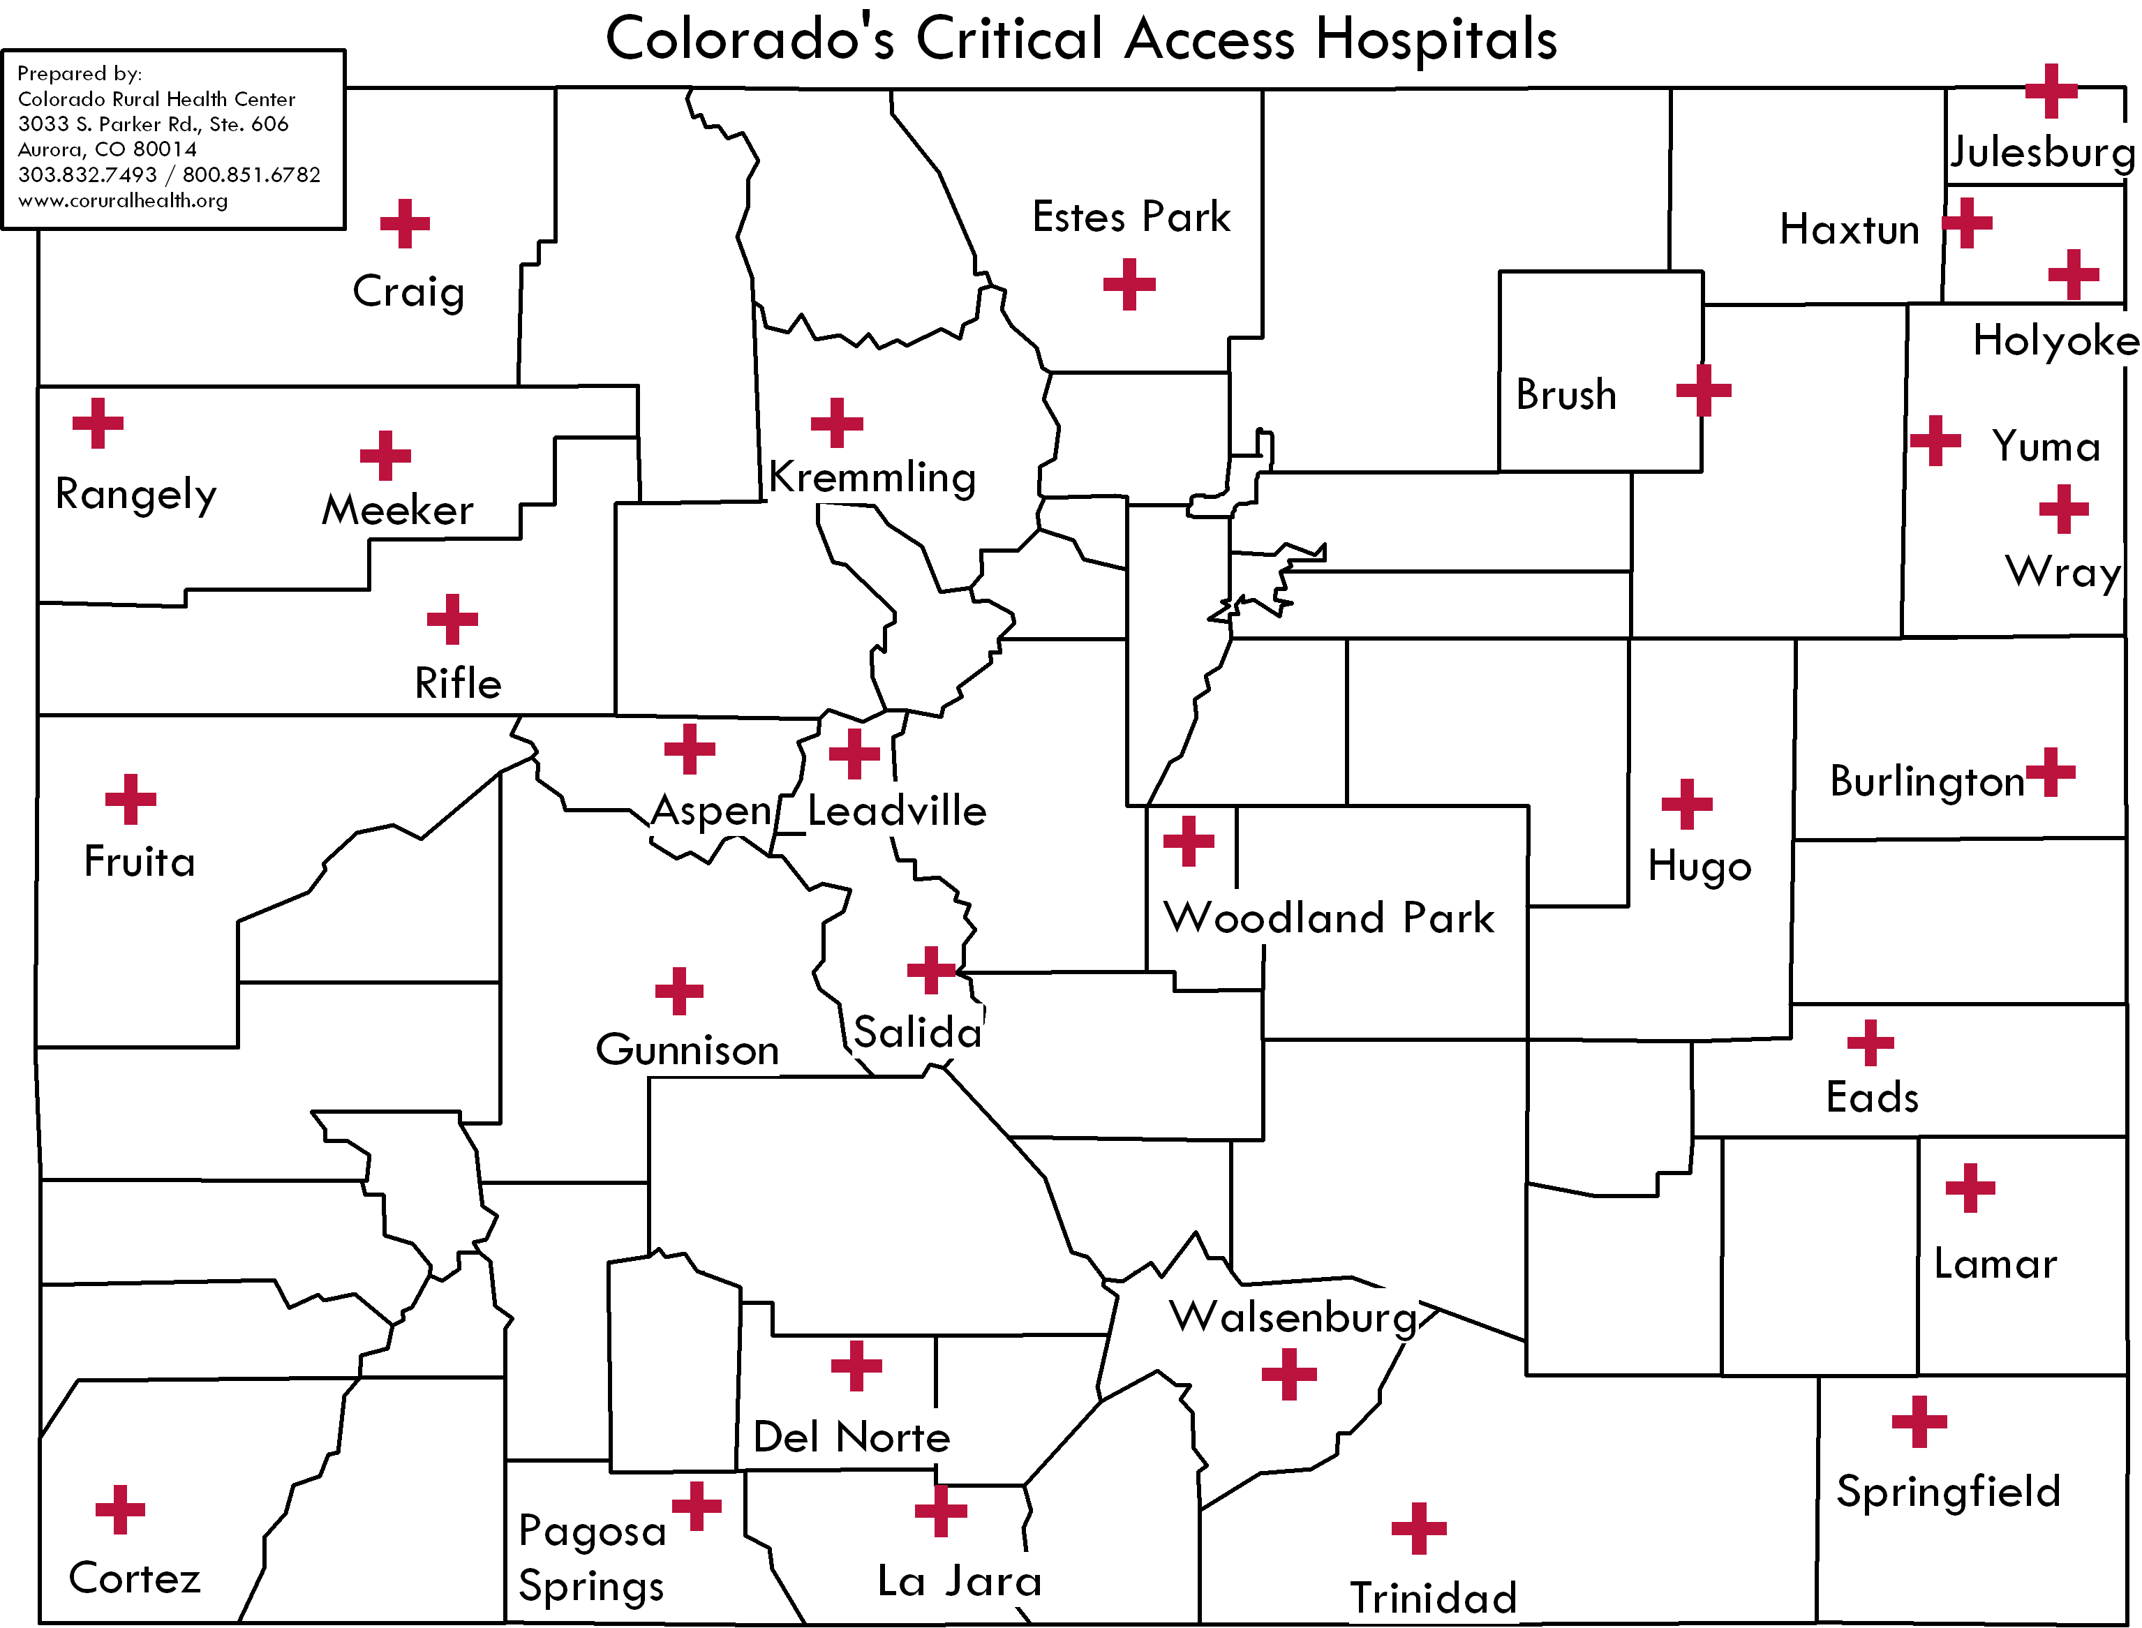
Culture & Coverage Forum

Slide 8
Culture & Coverage Forum
Considerations: Rural Outreach & Enrollment
Lack of staff & time to enroll in-house
RHCs must have strong relationships with other entities to refer patients to
RHCs receive better reimbursement for Medicaid than CHP+
Sliding fee scale may be more appealing to both the clinic & patient

Slide 9
Culture & Coverage Forum
Considerations: Rural Outreach & Enrollment
Mistrust of government
Strong sense of individualism
Stigma
Small town politics – may not want others to know they are receiving government assistance
Unknown how many providers are accepting NEW Medicaid & CHP+ or how long the wait is

Slide 10
Culture & Coverage Forum
Considerations: Rural Outreach & Enrollment
Insurance coverage is an important part in allowing an individual access to healthcare services, though an insurance card alone does not guarantee access.

Slide 11


